Slide 1

ITP20001/ECE 20010 Data Structures
Data Structures
Chapter 3
abstract data types - review
stacks & queues using dynamic arrays
some applications
infix to postfix – reading assignment - handout & section 3.6
Prof. Youngsup Kim, idebtor@handong.edu, 2014 Data Structures, CSEE Dept., Handong Global University

Slide 2
Chapter 3 – Stacks and queues
3.0 ADT - revisited
ADTs are a mathematical specification of a set of data and the set of operations (functions) that can be performed on the data.
We think of an ADT as a type defined in terms of its behavior rather than its implementation.
Technically, we define an ADT as a mathematical object and the operations on that object. Whenever we define an ADT, we give a definition and a list of operations.
ADTs typically can be implemented in many different ways.
Example: Fractions

Slide 3
Chapter 3 – Stacks and queues
3.0 ADT - revisited
Example: Fractions
A fraction consists of a numerator and denominator and is used when discussing parts of a whole.
Both the numerator and denominator of a fraction are integers. The denominator cannot be 0.
The operations on fractions include :
addition, subtraction, multiplication, division, reduce to lowest terms, find least common denominator, etc.
Since we have just defined a mathematical object (the fraction) and the operations on that object, we can say that a fraction is an abstract data type.
Are you ready to define ADT of stack and ADT of queue?

Slide 4
ITP2001/ECE 20010 Data Structures
Data Structures
Chapter 3
abstract data types - review
stacks & queues using dynamic arrays
some applications

Slide 5

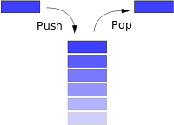
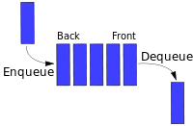
Chapter 3 – Stacks and queues
3.0 Stacks and queues
Fundamental data types:
Value: collections of objects
Operations: insert, remove, iterate, test if empty, test if full
Intent is clear when we insert.
Which item do we remove?
stack
queue
top
Stack: Examine the item most recently added. LIFO = "last in first out"
Queue: Examine the item least recently added. FIFO = "first in first out"

Slide 6
Chapter 3 – Stacks and queues
3.1 Stacks
ADT Stack is
objects: a finite ordered list with zero or more elements
functions: Stack CreateStack(maxStackSize) boolean IsFull(stack) boolean IsEmpty(stack) void Push(stack, item) Element Pop(stack)
Why ADTs?

Slide 7
Chapter 3 – Stacks and queues
3.1 Stacks
Why ADTs again?
Separate interface and implementation.
Ex: stack, queue, bag, priority queue, symbol table, union-find, .…
Benefits.
Client can't know details of implementation ⇒
client has many implementation from which to choose.
Implementation can't know details of client needs ⇒
many clients can re-use the same implementation.
Design: creates modular, reusable libraries.
Performance: use optimized implementation where it matters.
Client: program using operations defined in interface.
Implementation: actual code implementing operations.
Interface: description of data type, basic operations.

Slide 8
Chapter 3 – Stacks and queues
3.1 Stacks
Example: Stack of strings data type (implemented in Java)
public class | StackOfStrings
 | StackOfStrings() | create an empty stack
void | push(String item) | insert a new string onto stack
String | pop() | remove and return the string most recently added
boolean | isEmpty | is the stack empty?
boolean | isFull | is the statck full?
int | size() | member of strings on the stack
Warmup client: Reverse sequence of strings from standard input.

Slide 9
Chapter 3 – Stacks and queues
3.1 Stacks
Stack test client:
Read string from standard input.
If string equals "-", pop string from stack and print.
Otherwise, push string onto stack.
public static void main (String[] args) { StackOfStrings stack = new StackOfStrings(); while (!StdIn.isEmpty()) { String s = StdIn.readString(); if (s.equals("-") Stdout.print(stack.pop())); else stack.push(s); } }
Exercise:
%more tobe.txt
to be or not to – be - - that - - - is
% java StackOfStrings < tobe.txt
to be not that or be

Slide 10
Chapter 3 – Stacks and queues
3.2 Stacks using dynamic arrays
Array implementation of a stack:
Use array s[ ] to store N items on stack.
push(): add new item at s[N].
pop(): remove item from s[N-1].
s[ ]
to | be | or | not | to | be | null | null | null | null
0 | 1 | 2 | 3 | 4 | 5 | 6 | 7 | 8 | 9
N
capacity = 10
Defect. Stack overflows when N exceeds capacity. [stay tuned]

Slide 11
Chapter 3 – Stacks and queues
3.2 Stacks using dynamic arrays
public class FixedSizeStackOfStrings { private String[] s; private int N = 0; public FixedSizeStackOfStrings(int capacity) { s = new String[capacity]; } public boolean isEmpty() { return N == 0; } public void push(String item) { s[N++] = item; } public String pop() { return s[--N]; } }
a shortcoming
(stay tuned)
use to index into array;
then increment N
decrement N: then use to index into array

Slide 12
Chapter 3 – Stacks and queues
3.2 Stacks using dynamic arrays
Things to consider:
Overflow and underflow:
Underflow: throw exception if pop from an empty stack. (Java) or return null;
Overflow: use resizing array for array implementation. [stay tuned]
Null items: Allow null items to be inserted or not. Clarify during the design.
Loitering: Holding a reference to an object when it is no longer needed.
public String pop() { return s[--N]; }
public String pop() { String item = s[--N]; s[N] = null; return item; }
loitering
This version avoids "loitering": Garbage collector can reclaim memory only if no outstanding references.
In C/C++ implementation. free the resources it necessary.

Slide 13
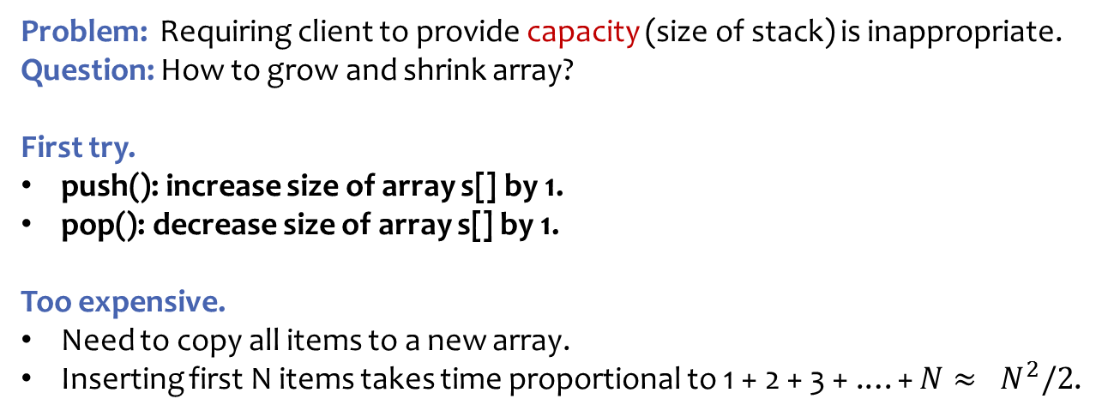
Chapter 3 – Stacks and queues
3.2 Stacks using dynamic arrays
Problem: Requiring client to provide capacity (size of stack) is inappropriate. Question: How to grow and shrink array?
First try.
push(): increase size of array s[] by 1.
pop(): decrease size of array s[] by 1.
Too expensive.
Need to copy all items to a new array.
Inserting first N items takes time proportional to 1 + 2 + 3 + .…+ ${N≈ N}^{2}/2$.
infeasible for large N
Challenge: Ensure that array resizing happens infrequently.

Slide 14
Chapter 3 – Stacks and queues
3.2 Stacks using dynamic arrays
"repeated doubling"
Q. How to grow and shrink array?
A. If array is full, create a new array of twice the size, and copy items.
public class ResizingStackOfStrings { s = new String[1]; } public void push(String item) { if (N == s.length) resize(s.length * 2); s[N++] = item; } private void resize(int capacity) { String[] copy = new String[capacity]; for (int i = 0; i < N; i++) copy[i] = s[i]; s = copy; }
Consequence: Inserting first N items takes time proportional to $N$, not $N^{2}$

Slide 15
Chapter 3 – Stacks and queues
3.2 Stacks using dynamic arrays
Q. Cost of inserting first $N$ items by resize(s.length + 10)?
A. $T\left(N\right)=1$ + ($10+20+30+…+N)$
1 array access per push
k array accesses when memory is resized by increment of 10
(ignoring cost to create new array in Java)
(assuming realloc() costs copying each item one by one in C)
When N = 1, Capacity = 1 → 11 // (?) cost to copy the existing items into the new array
Cost: 1 + (0) // (0) since no copy is needed
When N = 2, Capacity = 11 Cost: 1 + (0) // (0) items to copy into the new array
When N = 3, Capacity = 11
Cost: 1 + (0) // (0) since no copy is needed
When N = 4, Capacity = 11
Cost: 1 + (0)
….
When N = 11, Capacity = 11 → 21
Cost: 1 + (10) // (10) items to copy into the new array
When N = 12, Capacity = 21
Cost: 1 + (0)
….
When N = 21, Capacity = 21 → 31
Cost: 1 + (20) // (20) items to copy into the new array
When N = 22, Capacity = 31
Cost: 1 + (0)

Slide 16
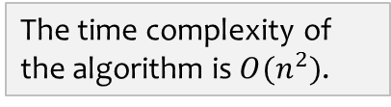
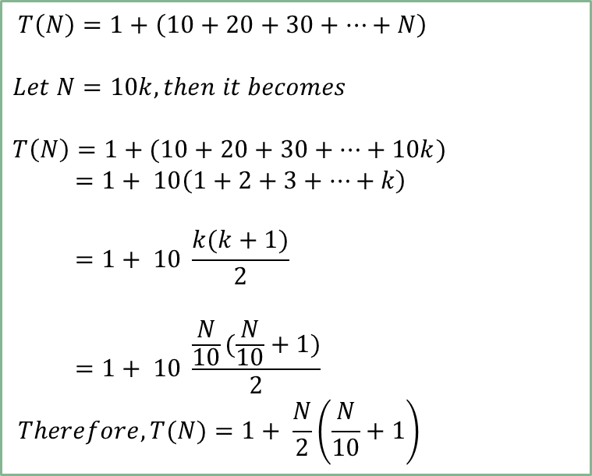
Chapter 3 – Stacks and queues
3.2 Stacks using dynamic arrays
Q. Cost of inserting first $N$ items by resize(s.length + 10)?
A. $T(N)=1$ + ($10+20+30+…+N)= ?$
How many terms? k terms, then N = 10k
$$T\left(N\right)=1+\left(10+20+30+…+N\right)$$
$$Let N=10k, then it becomes$$
$$T\left(N\right)=1+(10+20+30+…+10k)$$
$$=1+ 10\left(1+2+3+…+k\right)$$
$$=1+ 10 \frac{k(k+1)}{2}$$
$$=1+ 10 \frac{\frac{N}{10}(\frac{N}{10}+1)}{2}$$
$$Therefore, T(N)=1+ \frac{N}{2}\left(\frac{N}{10}+1\right)$$
The time complexity of
the algorithm is $O(n^{2})$.

Slide 17
Chapter 3 – Stacks and queues
3.2 Stacks using dynamic arrays
Q. Cost of inserting first $N$ items by resize(s.length * 2) ?
A. $T\left(N\right)=1+\left(1+2+4+8+…+N\right)$
1 array access per push
k array accesses to double to size k
(ignoring cost to create new array in Java)
(assuming realloc() costs copying each item one by one in C)
When N = 1, Capacity = 1
Cost: 1 + (0) // (?) cost to copy the existing items into the new array
When N = 2, Capacity = 1 → 2 Cost: 1 + (1) // (1) items to copy
When N = 3, Capacity = 2 → 4
Cost: 1 + (2) // (2) items to copy into the new array
When N = 4, Capacity = 4
Cost: 1 + (0) // (0) since no copy is needed
When N = 5, Capacity = 4 → 8
Cost: 1 + (4) // (4) items to copy into the new array
When N = 6, Capacity = 8
Cost: 1 + (0)
When N = 7, Capacity = 8
Cost: 1 + (0)
When N = 8, Capacity = 8
Cost: 1 + (0)
When N = 9, Capacity = 8 → 16
Cost: 1 + (8) // (8) items to copy into the new array

Slide 18
Chapter 3 – Stacks and queues
3.2 Stacks using dynamic arrays
Q. Cost of inserting first $N$ items by resize(s.length * 2) ?
A. $T\left(N\right)=1+\left(1+2+4+8+…+N\right)$
cost(array access)
one gray dot
for each operation
64
number of push() operations
32
red dots give cumulative average
3
0

Slide 19
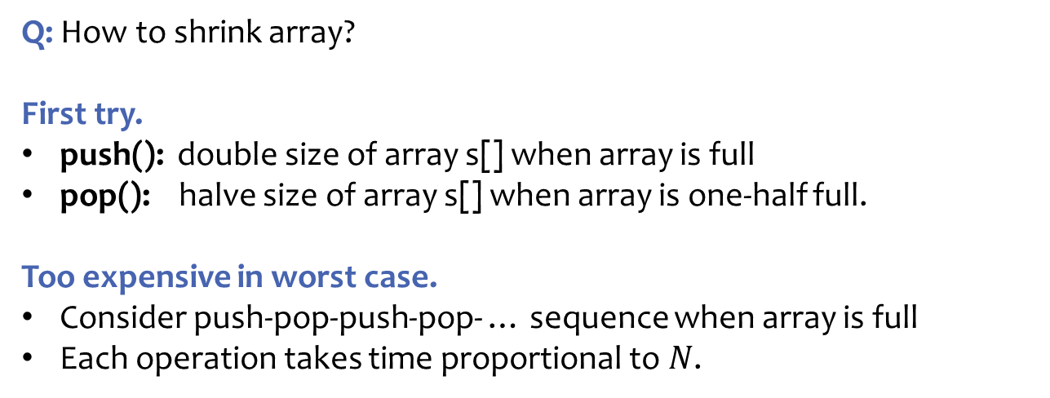
Chapter 3 – Stacks and queues
3.2 Stacks using dynamic arrays
Q: How to shrink array?
First try.
push(): double size of array s[] when array is full
pop(): halve size of array s[] when array is one-half full.
Too expensive in worst case.
Consider push-pop-push-pop- … sequence when array is full
Each operation takes time proportional to $N$.
N= 5
to | be | or | not | to | be | null | null
N= 4
to | be | or | not
N= 5
to | be | or | not | to | be | null | null
N= 4
to | be | or | not

Slide 20
Chapter 3 – Stacks and queues
3.2 Stacks using dynamic arrays
Q: How to shrink array?
Efficient solution
push(): double size of array s[] when array is full
pop(): halve size of array s[] when array is one-quarter full.
public String pop() { String item = s[--N]; s[N] = null; if (N > 0 && N == s.length/4) resize(s.length/2); return item; }
Invariant. Array is between 25% and 100% full.

Slide 21
Chapter 3 – Stacks and queues
3.2 Stacks using dynamic arrays
Amortized analysis: Average running time per operation over a worst-case sequence of operations.
Proposition: Starting from an empty stack, any sequence of N push and pop operations takes time proportional to N.
 | best | worst | amortized
construct | O(1) | O(1) | O(1)
push | O(1) | O(n) | O(1)
pop | O(1) | O(n) | O(1)
size | O(1) | O(1) | O(1)
doubling and
halving operations
order of growth of running time
for resizing stack with N items

Slide 22
ITP20001/ECE 20010 Data Structures
Data Structures
Chapter 3
abstract data types - review
stacks & queues using dynamic arrays
some applications

Slide 23

Chapter 3 – Stacks and queues
3.3 Queues

Slide 24
Chapter 3 – Stacks and queues
3.3 Queues
queue

Slide 25
Chapter 3 – Stacks and queues
3.3 Queues
Queue: An ordered list in which enqueues (insertion or add) at the rear and dequeues (deletion or remove) take place at different end or front.
It is also known as a Fist-in-first-out(FIFO) list.
queue

Slide 26
Chapter 3 – Stacks and queues
3.3 Queues
Queue: An ordered list in which enqueues (insertion or add) at the rear and dequeues (deletion or remove) take place at different end or front.
It is also known as a Fist-in-first-out(FIFO) list.
queue
Items can only be added at the rear of the queue and the only item that can be removed is the one at the front of the queue.

Slide 27
Chapter 3 – Stacks and queues
3.3 Queues
Queue: An ordered list in which enqueues (insertion or add) at the rear and dequeues (deletion or remove) take place at different end or front.
It is also known as a Fist-in-first-out(FIFO) list.
ADT Queue is
objects: a finite ordered list with zero or more elements
functions: Queue CreateQueue(maxQueueSize) boolean IsFull(queue, maxQueueSize) boolean IsEmpty(queue) void Add(queue, item) // Enqueue Element Delete(queue) // Dequeue

Slide 28
Chapter 3 – Stacks and queues
3.3 Queues
Example: Stack of strings data type (implemented in Java)
public class | QueueOfStrings
 | QueueOfStrings() | create an empty queue
void | enqueue(String item) | insert a new string onto queue
String | dequeue() | remove and return the string least recently added
boolean | isEmpty() | is the queue empty?
boolean | isFull() | is the queue full?
int | size() | member of strings on the queue

Slide 29
Chapter 3 – Stacks and queues
3.3 Queues
Array implementation of a queue:
Use array q[] to store items in queue.
enqueue(): add new item at q[tail].
dequeue(): remove item from q[head].
Update head and tail modulo the capacity.
Add resizing array.
q[ ]
null | null | the | best | of | times | null | null | null | null
0 | 1 | 2 | 3 | 4 | 5 | 6 | 7 | 8 | 9
head
front
tail
rear
capacity = 10
Q. How to resize?

Slide 30
Chapter 3 – Stacks and queues
3.3 Queues
Circular queue:
To avoid shifting array and resizing array which is costly
The array positions are handled in a circle rather than in a straight line.
rear
rear
rear
C
C
D
C
D
B
B
B
A
A
front
front
front
(a) Initial
(b) Addition/Enqueue
(c) Deletion/Dequeue

Slide 31
Chapter 3 – Stacks and queues
3.3 Queues
Circular queue:
To be circular, the position next to position MAX_QSIZE-1 is 0, the position that precedes 0 is MAX_QSIZE-1
By convention, the first item is located at (front + 1) position.
If front = rear, then queue is empty or full? To distinguish this case, double the queue size just before it becomes full.
The initial value for front and rear is 0.
first item
(MAX_QSIZE-1) ← 0
(MAX_QSIZE-1) → 0
q[ ]
C | D | E | F | G |  | A | B
0 | 1 | 2 | 3 | 4 | 5 | 6 | 7
rear
front
capacity = 8
MAX_QSIZE

Slide 32
Chapter 3 – Stacks and queues
3.3 Queues
Circular queue:
Use integer variables front and rear.
front is one position counterclockwise from first element
rear gives position of last element
[2]
[3]
[2]
[3]
A
B
rear
rear
front
front
C
C
[1]
[4]
[1]
[4]
B
A
[0]
[5]
[0]
[5]

Slide 33
Chapter 3 – Stacks and queues
3.3 Queues
Circular queue:
Add an element
Move rear one clockwise.
[2]
[3]
A
B
rear
front
[1]
C
[4]
[0]
[5]

Slide 34
Chapter 3 – Stacks and queues
3.3 Queues
Circular queue:
Add an element
Move rear one clockwise.
Then put into queue[rear].
[2]
[3]
A
B
front
[1]
C
[4]
D
[0]
[5]
rear

Slide 35
Chapter 3 – Stacks and queues
3.3 Queues
Circular queue:
Delete an element
Move front one clockwise.
[2]
[3]
A
B
front
[1]
C
[4]
D
[0]
[5]
rear

Slide 36
Chapter 3 – Stacks and queues
3.3 Queues
Circular queue:
Delete an element
Move front one clockwise.
Then extract from queue[front]..
front
[2]
[3]
B
[1]
C
[4]
D
[0]
[5]
rear

Slide 37
Chapter 3 – Stacks and queues
3.3 Queues
Circular queue:
Empty that queue
[2]
[3]
rear
front
C
[1]
[4]
B
A
[0]
[5]

Slide 38
Chapter 3 – Stacks and queues
3.3 Queues
Circular queue:
Empty that queue
[2]
[3]
rear
C
[1]
[4]
B
[0]
[5]
front

Slide 39
Chapter 3 – Stacks and queues
3.3 Queues
Circular queue:
Empty that queue
[2]
[3]
rear
C
[1]
[4]
[0]
[5]
front

Slide 40
Chapter 3 – Stacks and queues
3.3 Queues
Circular queue:
Empty that queue
[2]
[3]
rear
C
[1]
[4]
front
[0]
[5]
When a series of removes causes the queue to become empty, front = rear.
When a queue is constructed, it is empty.
So initialize front = rear = 0.

Slide 41
Chapter 3 – Stacks and queues
3.3 Queues
Circular queue:
Full that queue
[2]
[3]
rear
front
C
[1]
[4]
B
A
[0]
[5]

Slide 42
Chapter 3 – Stacks and queues
3.3 Queues
Circular queue:
Full that queue
[2]
[3]
rear
D
front
C
[1]
[4]
B
A
[0]
[5]

Slide 43
Chapter 3 – Stacks and queues
3.3 Queues
Circular queue:
Full that queue
rear
[2]
[3]
D
E
front
C
[1]
[4]
B
A
[0]
[5]

Slide 44
Chapter 3 – Stacks and queues
3.3 Queues
Circular queue:
Full that queue
[2]
[3]
D
E
rear
front
C
[1]
F
[4]
B
A
[0]
[5]
When a series of adds causes the queue to become full, front = rear.
So we cannot distinguish between a full queue and an empty queue!

Slide 45
Chapter 3 – Stacks and queues
3.3 Queues
Circular queue:
Challenge: front = rear when queue is empty and full.
Solutions:
Don’t let the queue get full.
When the addition of an element will cause the queue to be full, increase array size.
This is what the text does.
Define a boolean variable lastOperationIsAddQ.
Following each AddQ set this variable to true.
Following each DeleteQ set to false.
Queue is empty iff (front == rear) && !lastOperationIsAddQ
Queue is full iff (front == rear) && lastOperationIsAddQ

Slide 46
Chapter 3 – Stacks and queues
3.3 Queues
Circular queue:
Challenge: front = rear when queue is empty and full.
Solutions: (continued)
Define an integer variable size.
Following each AddQ do size++.
Following each DeleteQ do size--.
Queue is empty iff (size == 0)
Queue is full iff (size == arrayLength)
Performance is slightly better when first strategy is used.

Slide 47
ECE 20010 Data Structures
Data Structures
Chapter 3
abstract data types - review
stacks & queues using dynamic arrays
some applications
Youngsup Kim, idebtor@handong.edu, Handong Global University

